Slide 1
Image matting using u²-net
19521450- Trang Trường Giang
19521607 – Hoàng Gia Huy

Slide 2
Table of content
PROBLEM DISCRIPTION
PROPOSED METHOD
DATASET DISCRIPTION
DISCRIPTION APPLICATION AND DEMO
CONCLUSION

Slide 3
Image matting

Slide 4
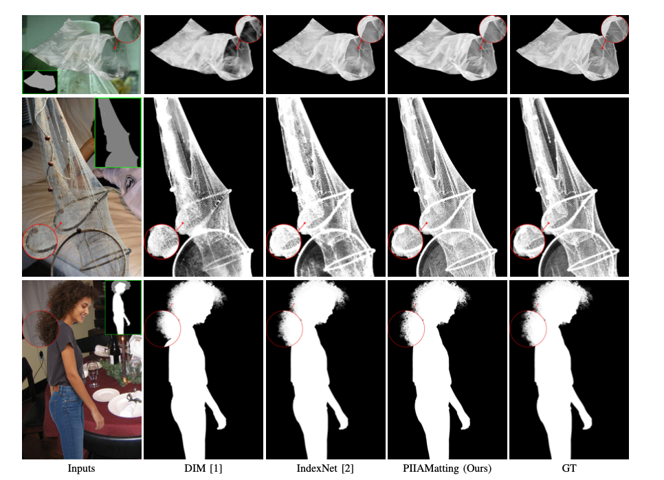
What is image matting
Image matting is the process of separating an image into foreground and background components, while also estimating the opacity of each pixel. This means, for each pixel in the image, we want to know:
Is it part of the foreground object or the background?

Slide 5
PROBLEM DISCRIPTION

Slide 6
PROBLEM DISCRIPTION
INPUT: a high-resolution real-world portrait photo of a person or 2 people with variety of backgrounds, size 512x512
OUTPUT: will be a mask of the same size as the Input, each pixel has a value from 0-1 representing the % of that pixel contributing to the foreground and background.

Slide 7
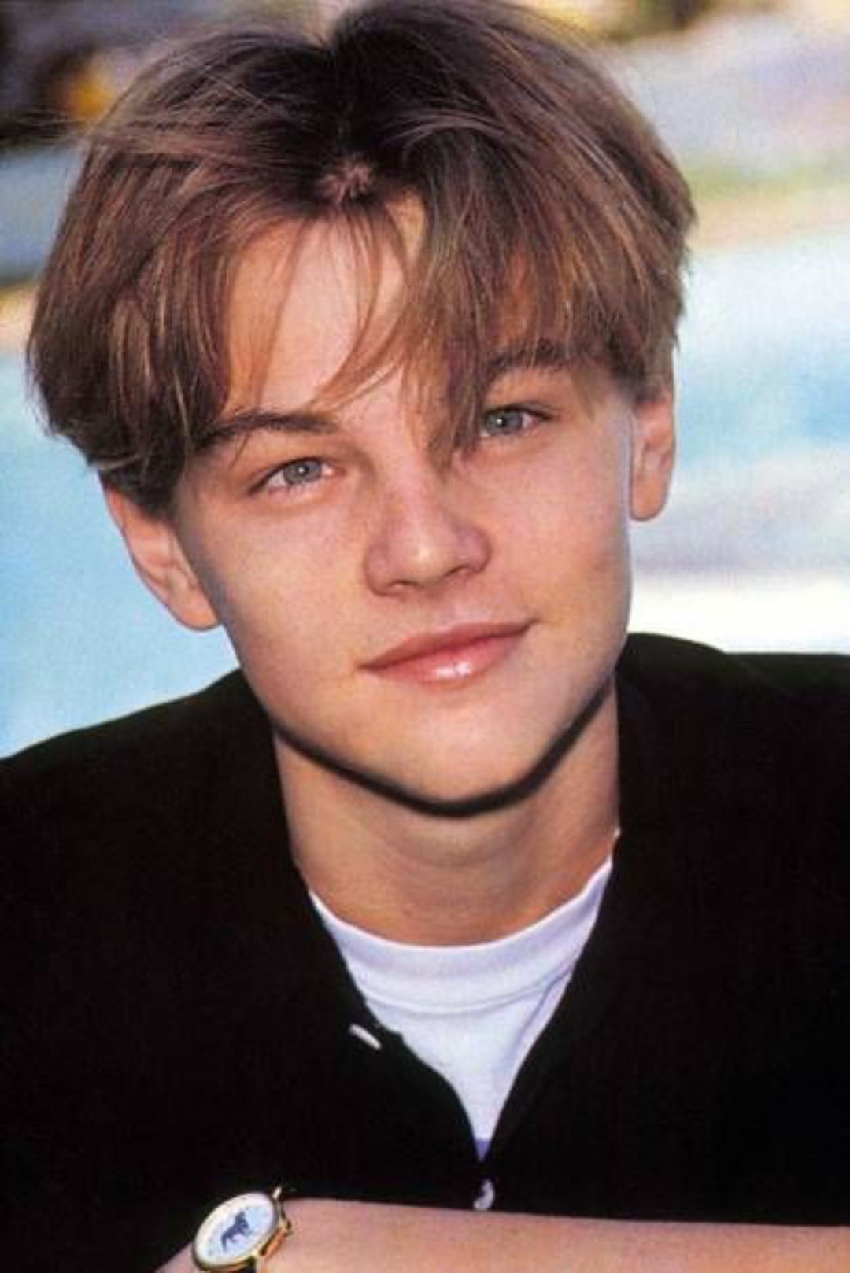

PROBLEM DISCRIPTION

Slide 8
Proposed method

Slide 9
U²-net model
- An architecture for Salient Object Detection (SOD).
- It is a two-level nested U-shaped architecture build using the proposed ReSidual U-blocks (RSU).
- U2-Net does not use pre-trained backbone

Slide 10
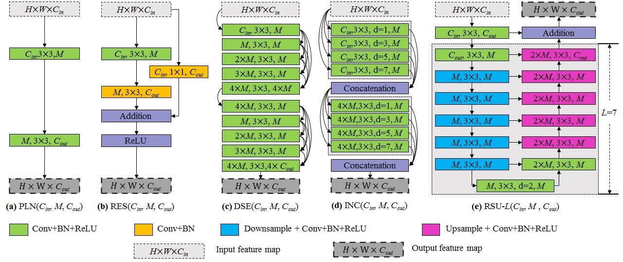
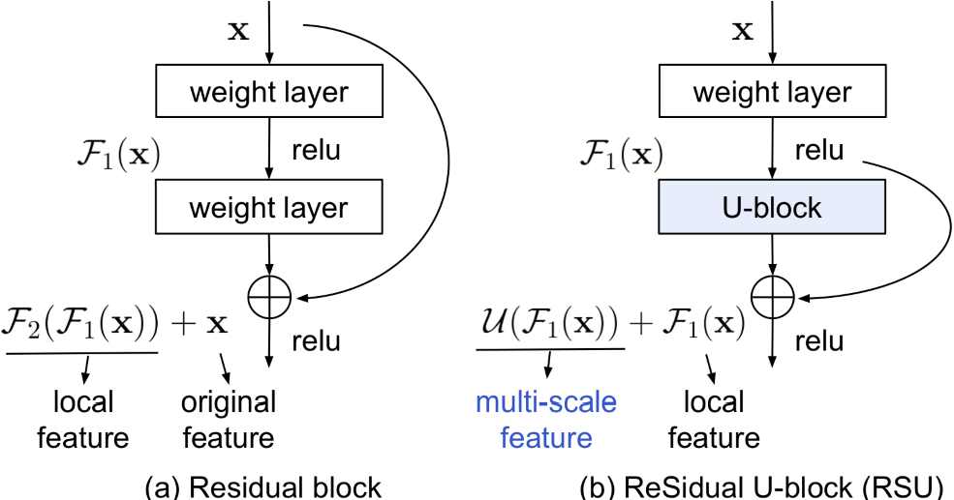
Residual u-blocks (rsu)
Cin – input channels
Cout – output channels
M - intermediate channels
L – number of layers
=> Capture intra-stage multi-scale features

Slide 11
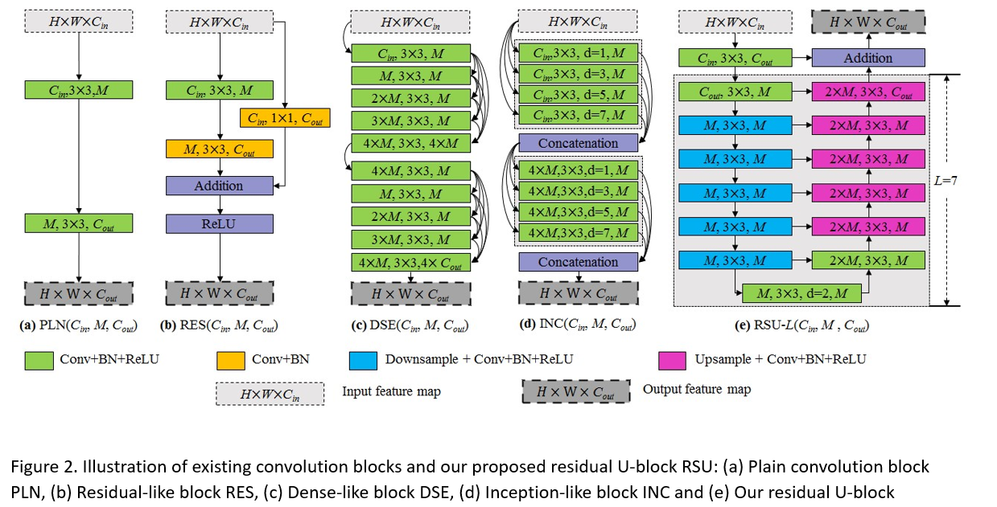
Residual u-blocks (rsu)

Slide 12
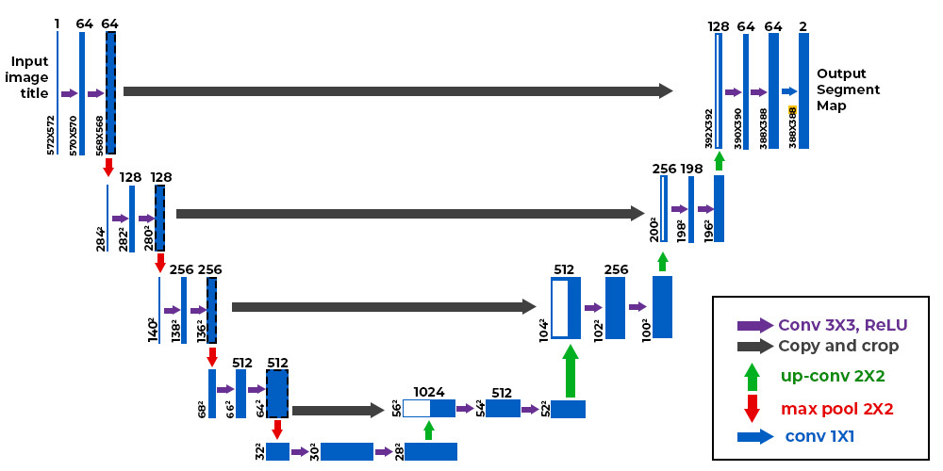
Architecture of u-net

Slide 13
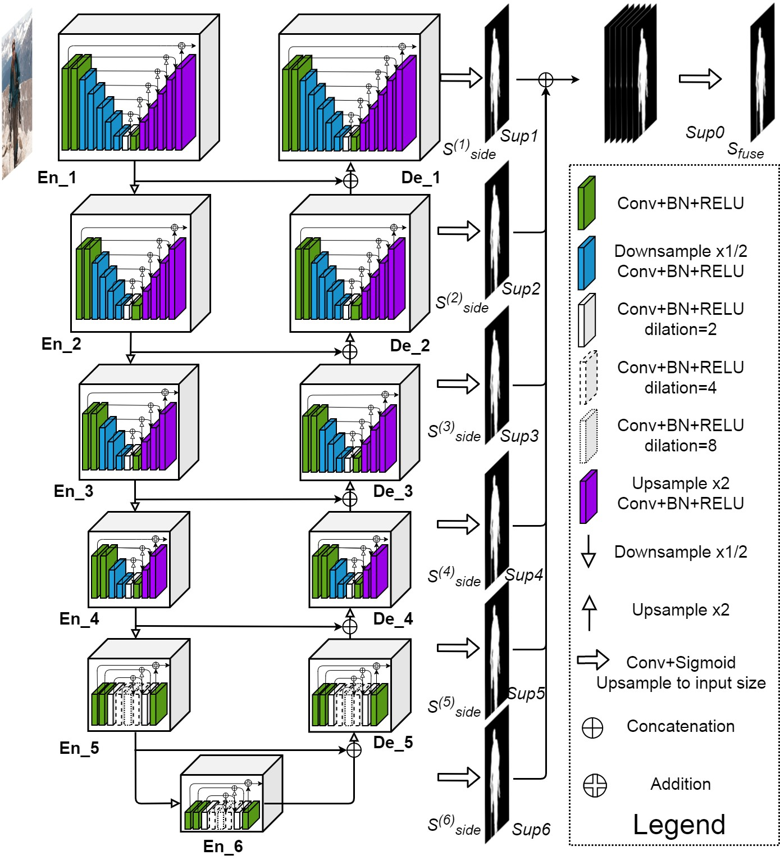
Architecture of u²-net

Slide 14
DATASET DISCRIPTION

Slide 15
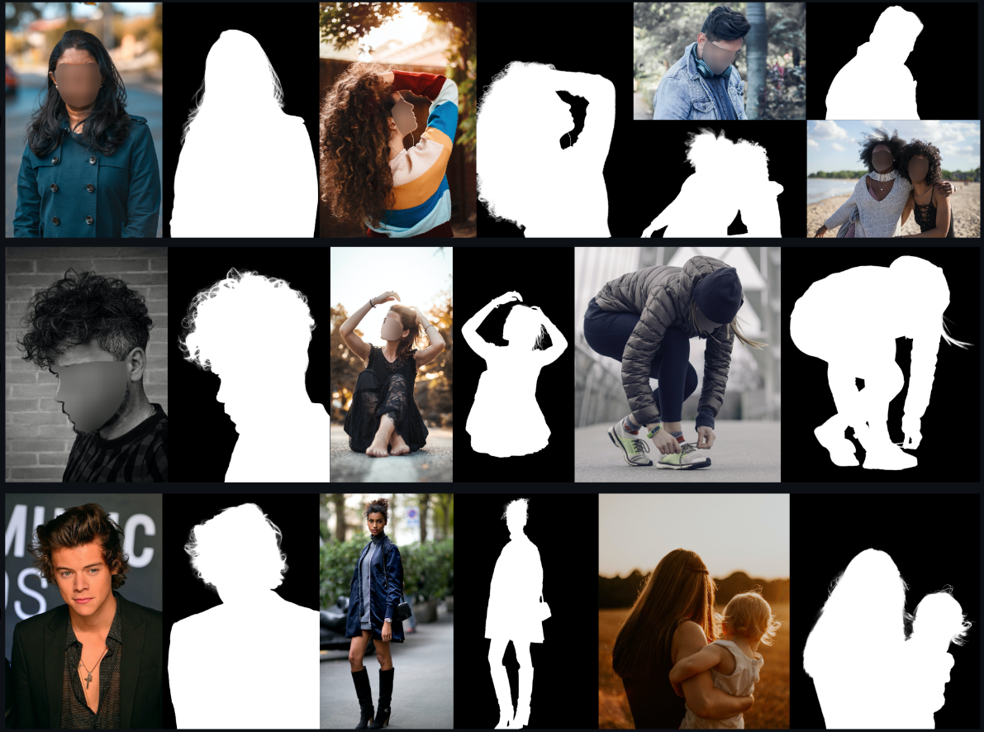
DATASET DISCRIPTION
We using the P3M-10k dataset, it have over 10.000 images with high resolution, portrait photos of people with diverse back grounds

Slide 16


DATASET DISCRIPTION
Train dataset : all the images will be blured people’s face if they are not celebrities

Slide 17
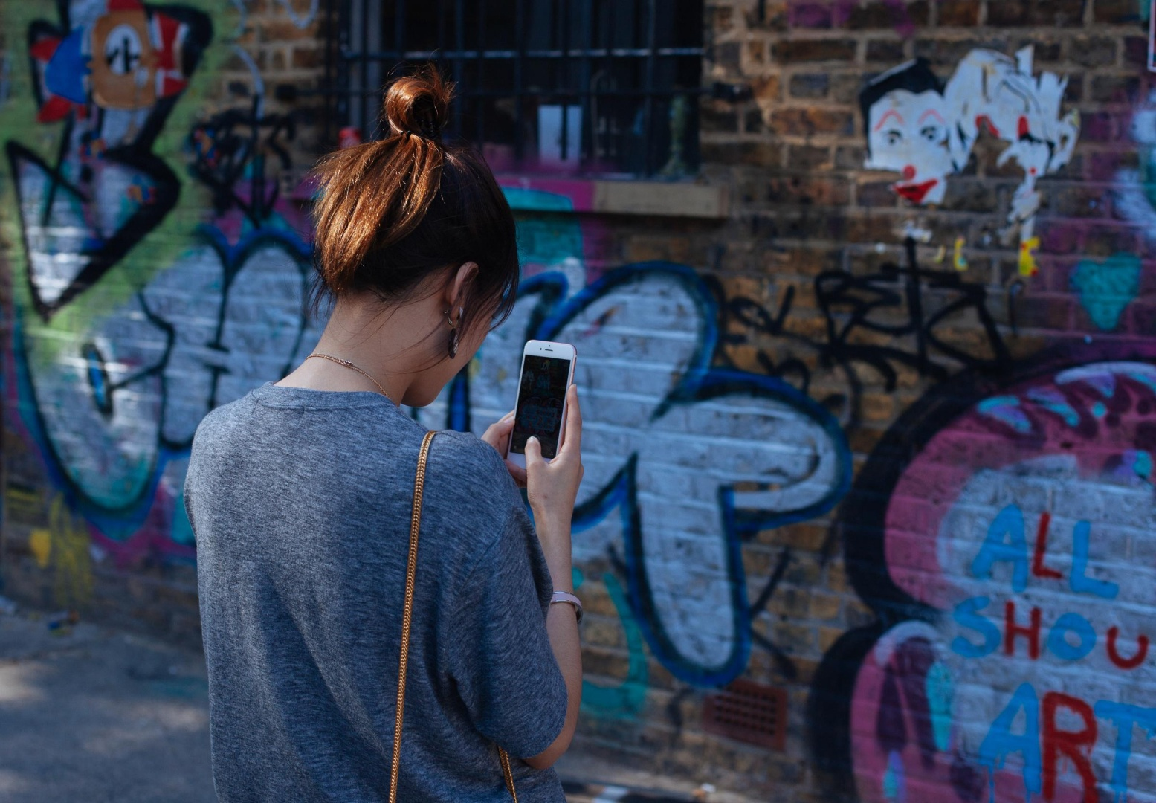
DATASET DISCRIPTION
Validation dataset : in validation dataset we don’t cover up people’s face but the foreground uses more than 50% of the image area

Slide 18
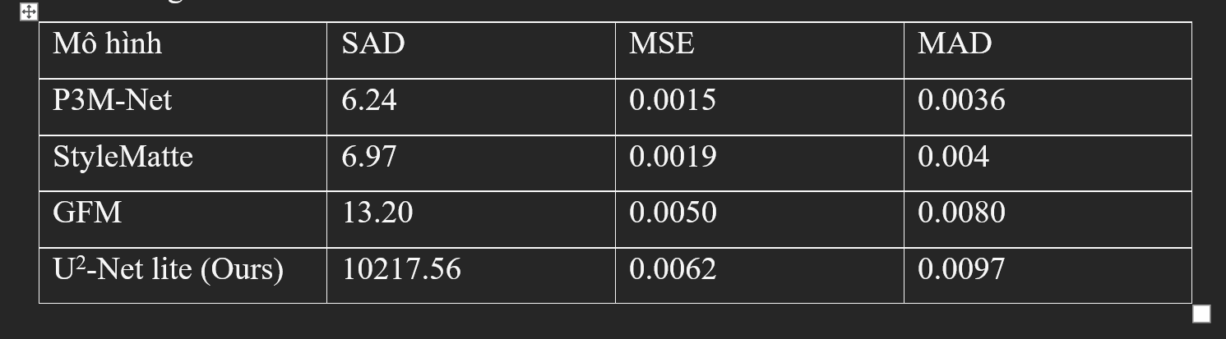
Training result

Slide 19
Application discription

Slide 20
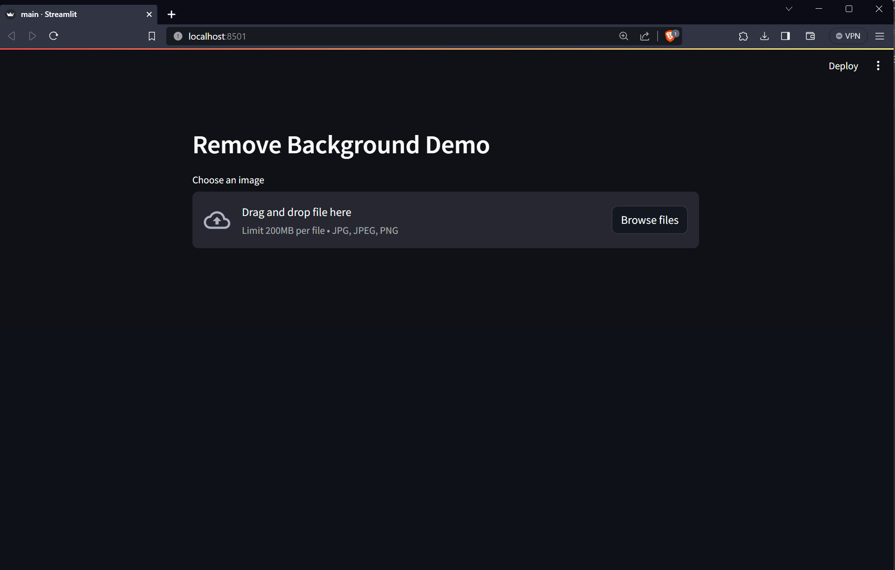
Application discription

Slide 21

Application discription

Slide 22
demo

Slide 23
Conclusion

Slide 24
Division of work
 | Phân chia công việc
Hoàng Gia Huy | Train model,code giao diện ,thuyết trình, xử lý data
Trang Trường Giang | Tìm kiếm tài liệu, thuyết trình

Slide 25
References
[1] U^2-Net: Going Deeper with Nested U-Structure for Salient Object Detection
[2] Dataset P3M-10k
[3] Privacy -Preserving Portrait Matting

Slide 26
THANK YOU

